Slide 1
Android Boot-Up Sequence

Slide 2
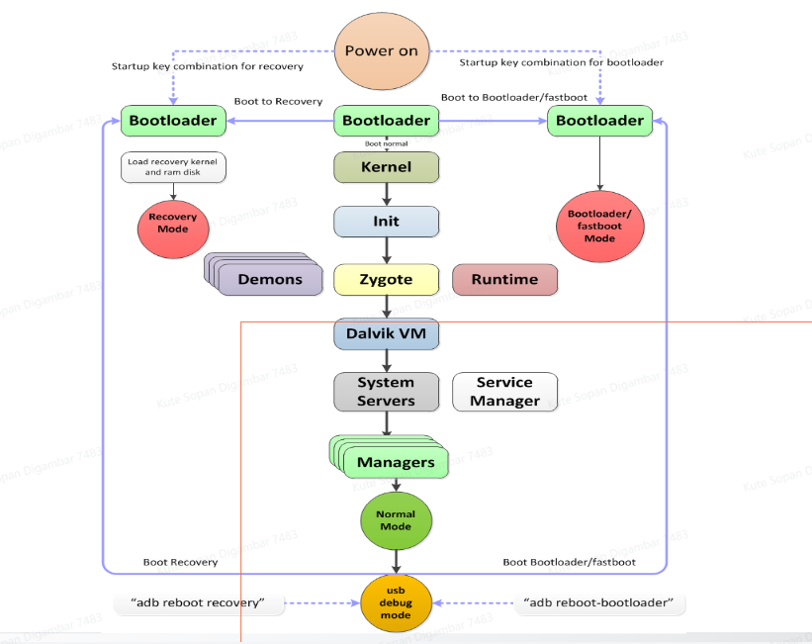

Slide 3
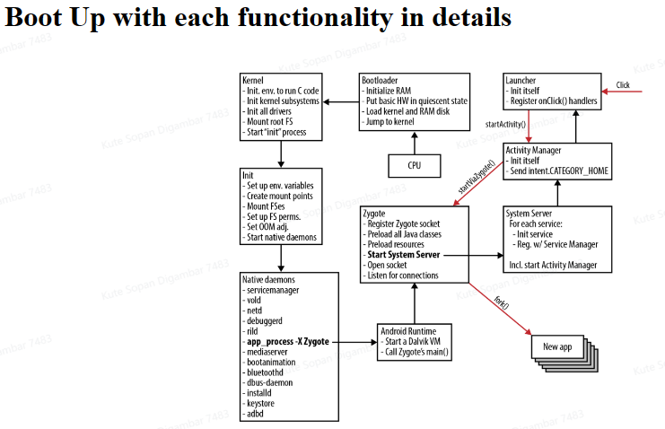

Slide 4
Android Booting Sequence
Switching OFF the power and switch ON it again.
Step 1: Boot ROM
Press the power button, the Boot ROM code starts executing from a pre-defined location which is hardwired in ROM.
Loads the Bootloader into RAM and starts executing.

Slide 5
Step 2: Bootloader
first small program and responsible for bringing up the kernel on a device.
Hardware specific and it is NOT part of the Android specific (Android OS).
Tell a device how to start-up and find System Kernel.
The bootloader is the place where manufacturer puts their locks and restrictions.
It is highly secured coz it figures out where the kernel image is to be loaded from.

Slide 6
The Bootloader executes in two stages.
First Stage
It detects external RAM and loads a program.
Provide support for loading Recovery image to the System flash.
Load the boot images, as boot.img, vendor_boot.img, init_boot.img etc.

Slide 7
Second Stage
Bootloader loads Kernel from Boot-partition.
Setups the System files, Network, Memory, etc. which requires to run kernel.
Android devices include several partitions that serve different functions in the boot process. There are different Boot partitions: Cache, Misc., UserData, Boot, System, etc.
<android source>/bootable/bootloader/legacy/usbloader

Slide 8
Step 3: Kernel
The Android kernel starts in a similar way as the Linux kernel.
Once kernel Boots, it starts to setup Cache, Protected memory, Scheduling, loads Drivers, starts kernel daemons.
it looks for “init” in the system files.

Slide 9
Binder (IPC) : Interprocess Communication Mechanism
Ashmem : "Android Shared Memory".
Pmem : "Process memory allocator" (memory shared between userspace and kernel drivers.)
Logger : support for the logcat command.
wake locks : It is used to make efficient use of power management.
oom handling (OutOfMemory Error) : It kills processes as available memory becomes low.
alarm manager : It lets user space tell the kernel when it would like to wake up.

Slide 10
Step 4: init process
First process or Root of all processes.
It is a program to initialize the elements of the Android system.
The init process has two responsibilities.
1. Creates many directories like /sys, /dev or /proc
2. Runs init.rc script. - provides the generic initialization instructions
- Starts Native Daemons : usdb, rild, adbd etc.
- Start Zygote Process .
At this stage, you can finally see the Android logo in your screen.
PID for init process = 1

Slide 11
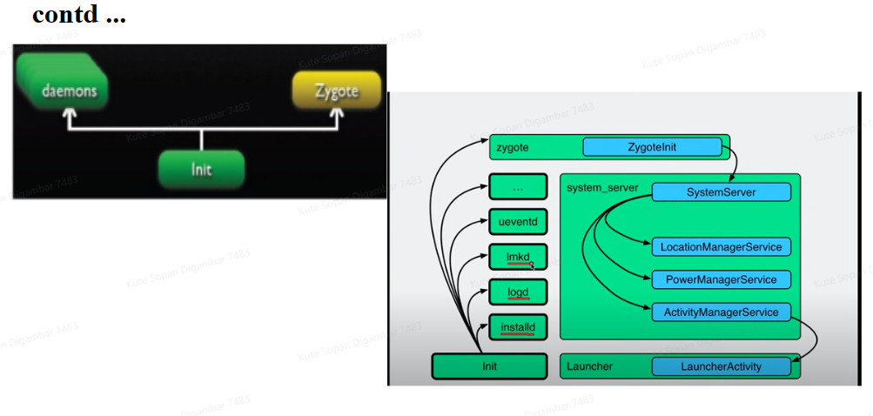

Slide 12
Step 5: Zygote and DVM
It is VM process in Android that starts at System boot and handles the forking of each new application process.
Each new Zygote process is a child of the original Zygote process and includes a VM.
When the command app_process launches the Zygote , the first VM instance is created. The VM then calls Zygote’s main () function.
Zygote forks itself to form a base for other Applications and the application is then bound to the thread of this process. Thus each application runs in its own Linux process, with its own thread.

Slide 13
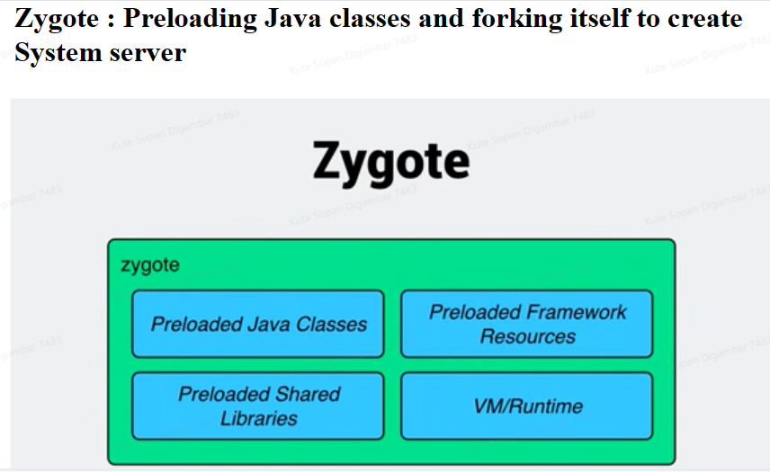
Zygote and Dalvik VM is written in Java.
The Android OS has a system called “Zygote”.
Load Zygote Init class:
<androidsource>/frameworks/base/core/java/com/android/internal/os/ZygoteInit.java

Slide 14
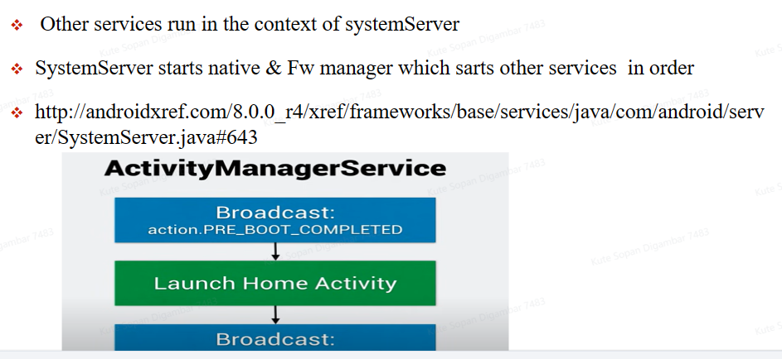

Slide 15
Step 6: System service
Zygote launches the System Server. The Zygote forks a new process to launch the system services.
The System server is started as soon as Dalvik is initialized and running.
SystemServer contains many services such as Activity manager, Package manager, Window manager etc.
Then the native init method that will set up native services is called.

Slide 16
And more…
After setting-up the native services it creates the server thread. this thread will start the remaining services in system as according to necessary.
Each service is running in a separate Dalvik thread in the SystemServer process .
Once system services up and running in Memory, Android has Completed boot process. After "ACTION_BOOT_COMPLETED" standard broadcast action will fire

Slide 17
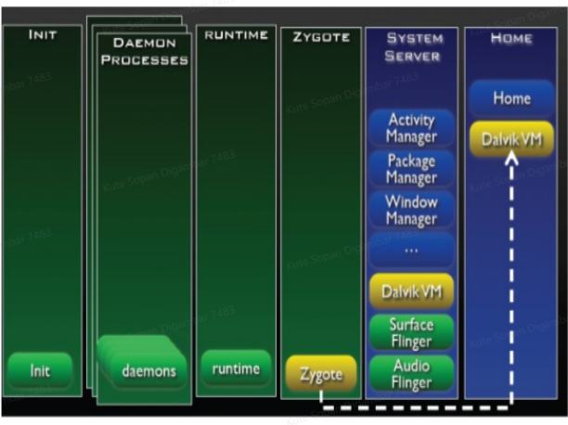

Slide 18


Slide 19
Thank
You !!!

